Slide 1
Programming Fundamentals
Week – 15
by Abeeha Sattar

Slide 2
Dynamic Memory Allocation
Remember the stuff with “stack” and “heap”?
We said that variable allocated inside functions, or as parameters were created within the stack.
Now, let’s talk about a different type of memory allocation.
What if you want to create something at runtime? You can’t do this inside the code.

Slide 3
So, how does DMA work?
If you only want to allocate memory when it is needed, then DMA is the way to go.
The memory also exists “outside of” functions – aka, not on the stack. It exists on the “heap”.
This means, after a function exits, if I created something on the heap, it does not get destroyed along with other static function variables.

Slide 4
DMA – the Functions that Help with this…
malloc()
calloc()
realloc()
free()
These functions exist in stdlib.h, and help you manage the program memory during runtime.

Slide 5
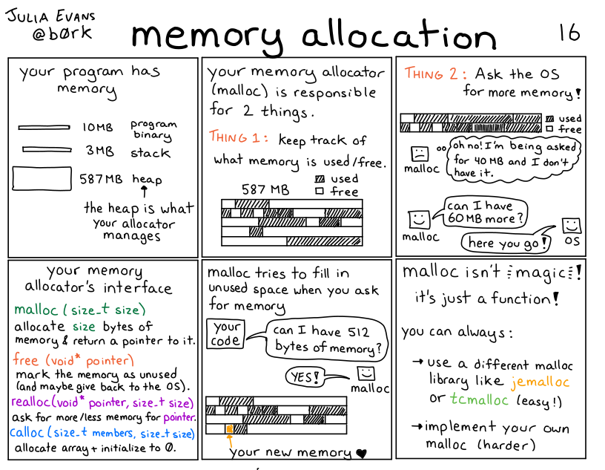
Memory Allocation

Slide 6
The ‘malloc’ Function
Memory allocation – malloc
It is responsible for memory allocations.
It accepts the size of memory(int bytes) that you want to allocate.
It returns a void pointer.
This void pointer can then be cast into a pointer of your choice…
type *ptr = (*type) malloc (size)

Slide 7
Examples
Allocate memory equal to 4 bytes, then cast the void pointer to int*
int *ptr = (int*) malloc(sizeof(int));
Allocate memory equal to 400 bytes, then cast the void pointer to float*
float *f_ptr = (float*) malloc(sizeof(float));
Can do the same for any other data type.

Slide 8
The ‘calloc’ Function
Contiguous allocation – calloc
Along with allocating memory, it allocates the memory as “elements” – like in an array.
It also initializes everything within the allocated memory to 0.
It accepts the number of total elements and the size of each element.
It returns a void pointer to the first index.
type *ptr = (type*) calloc(num_elements, size_of_element);

Slide 9
Examples
A dynamic array of 100 integers
int *i_arr = (int*) calloc (100, sizeof(int));
A dynamic array of 100 floats
float *f_arr = (float*) calloc (100, sizeof(float));

Slide 10
The ‘realloc’ Function
If the dynamically allocated memory is insufficient or more than required, you can change the size of previously allocated memory using the realloc() function.
If enough space doesn’t exist in memory of current block to extend, new block is allocated for the full size of reallocation, then copies the existing data to new block and then frees the old block.
Returns NULL if allocation fails.
type *ptr = (type*) realloc(ptr_to_memory_block, new_size);

Slide 11
Examples
Reallocating space for ‘ptr’ from our previous example.
It was originally 4 bytes, now it would be 40 bytes/
int *temp = (int*) realloc (ptr, 10*sizeof(int));
if(temp != NULL) ptr = temp;
Reallocating space fpr ‘f_arr’ from our previous example.
It was originally 400 bytes, now it would be 40 bytes.
float *temp_ = (float*) realloc (f_arr, 10*sizeof(float));
if(temp_ != NULL) f_arr = temp_;

Slide 12
The ‘free’ Function
Unlike function variables, the memory allocated via malloc/calloc/realloc does not get freed on its own after the function exits.
You need to manually tell the program the free that block of memory.
While a block is not free, nothing else is allowed to use that block.
It is not available to be allocated
C does not free memory automatically, so you must use free to do so.

Slide 13
Example
Freeing the memory of ptr:
free (ptr);
ptr = NULL;
When freeing memory, you should make the pointer NULL afterwards.
This ensures that the pointer is not a dangling pointer.

Slide 14
Back to Dangling Pointers
A pointer that is pointing to a memory that has been freed.
You can use it to modify that memory like any other pointer.
But keep in mind that, that memory might get used by something else within your program, or modified since it’s not “allocated” by your program anymore.

Slide 15
Memory Leaks ☹
Memory leaks occur when you allocate a memory block and then lose the address to it.
Think like, creating an email account, then forgetting the credentials for it. You can’t login without the credentials.
Here, credentials = address. If you lose the address, you cannot access the memory.
If you cannot access the memory, you cannot free it.
If you cannot free the memory, your program cannot reuse it for anything else.

Slide 16
Treating a 1D Array as a 2D Array
First assume some size that you want your 2D-Array to be.
Let’s say 4x3. 4 rows and 3 columns. That’s a total of 12 elements.
If I allocate a 1D array:
int *arr = (int*) malloc(row*col * sizeof(int)); //block size: RxCx4
Now how would you access an element at 3rd row, 2nd column?
arr[i*row + j]

Slide 17
Double Pointers
Basically: “I know a guy who knows a guy”
char AGuy = ‘A’;
char* AGuyWhoKnowsAGuy = &AGuy;
char** I = & AGuyWhoKnowsAGuy;

Slide 18
Where do we wanna use Double Pointers?
Single ‘char’ takes up one character(duh)
If I want a word I make and array of characters aka, single pointer.
If I want a collection of words, each word in a different line, I would use a 2D array, or double pointers!
You could do triple, quadruple, quintuple pointers. But our brain isn’t really good at picturing things past 3D.

Slide 19
Saw this on StackOverflow, can’t find the link ☹
If you want to have a list of characters (a word), you can use char *word
If you want a list of words (a sentence), you can use char **sentence
If you want a list of sentences (a monologue), you can use char ***monologue
If you want a list of monologues (a biography), you can use char ****biography
If you want a list of biographies (a bio-library), you can use *****biolibrary
If you want a list of bio-libraries (a ??1o1), you can use *****lol

Slide 20
2D-Arrays Using DMA
We need double pointers for those!
Let’s say for a RxC dimension 2D Array.
First create a double pointer - this would be pointing to the 2D array
int** my2dArr;
Then allocate R double pointers which will serve as pointer to each row.
my2dArr = (int**) malloc(R*sizeof(int*));

Slide 21
2D-Arrays Using DMA
Then for each row, allocate C columns that would be pointing to an integer block.
for (int i = 0; i < R; i++){
my2dArrd[i] = (int*) malloc (C*sizeof(int));
if (my2dArr[i] == NULL) {
printf("Memory allocation failed for col %d.\n", i+1);
for (int j = 0; j < i; j++)
free(my2dArrp[j]);
free(my2dArr);
}
}

Slide 22
The allocated chunks would look something like this… For R=5, C=7
00 | 01 | 02 | 03 | 04 | 05 | 06
int** my2dArr
my2dArr[0]
my2dArr[1]
my2dArr[2]
my2dArr[3]
my2dArr[4]
10 | 11 | 12 | 13 | 14 | 15 | 16
Memory allocated via the
(int*) malloc (C*sizeof(int))
statement in the code
20 | 21 | 22 | 23 | 24 | 25 | 26
30 | 31 | 32 | 33 | 34 | 35 | 36
40 | 41 | 42 | 43 | 44 | 45 | 46
Has datatype of int* - points to a block that will have C-columns
Each of these elements would be addressed as my2dArr[row_num][col_num]

Slide 23
Now that you know how to DMA stuff…
Write a function that accepts number of rows(R) and columns(C), initializes a 2D array with RxC dimensions, and returns the pointer to it.
If the allocation fails, returns NULL.
Perform proper memory management – in case allocation fails mid way, it should deallocate the allocated blocks before returning NULL.
In your main, call that function and store that pointer in a variable.

Slide 24
Fin.

